Slide 1
Snake Party
Miguel Carter Cory Smith Uriel Correa Michael Bonner Luke Vander Lugt
“It’s like a regular snake game but with more players” - Peter Trefonas

Slide 2
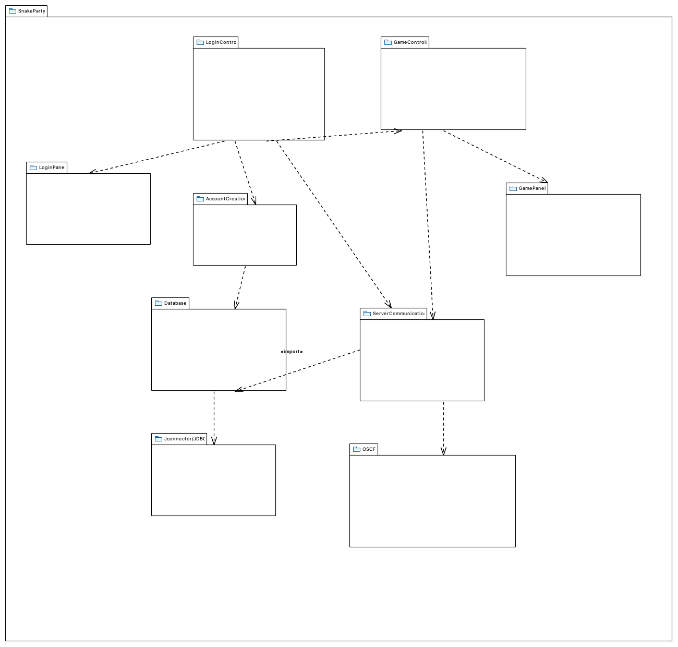
Initial Package Diagram
The original package diagram that we created during the design phase.
-LoginPanel - Cory, Michael
-LoginControl - Cory, Michael
-GameControl - Miguel, Luke
-GamePAnel - Miguel, Luke
-AccountCreatePanel - Michael, Uriel
-ServerCommunication - Miguel, Cory
-Database - Cory, Uriel

Slide 3
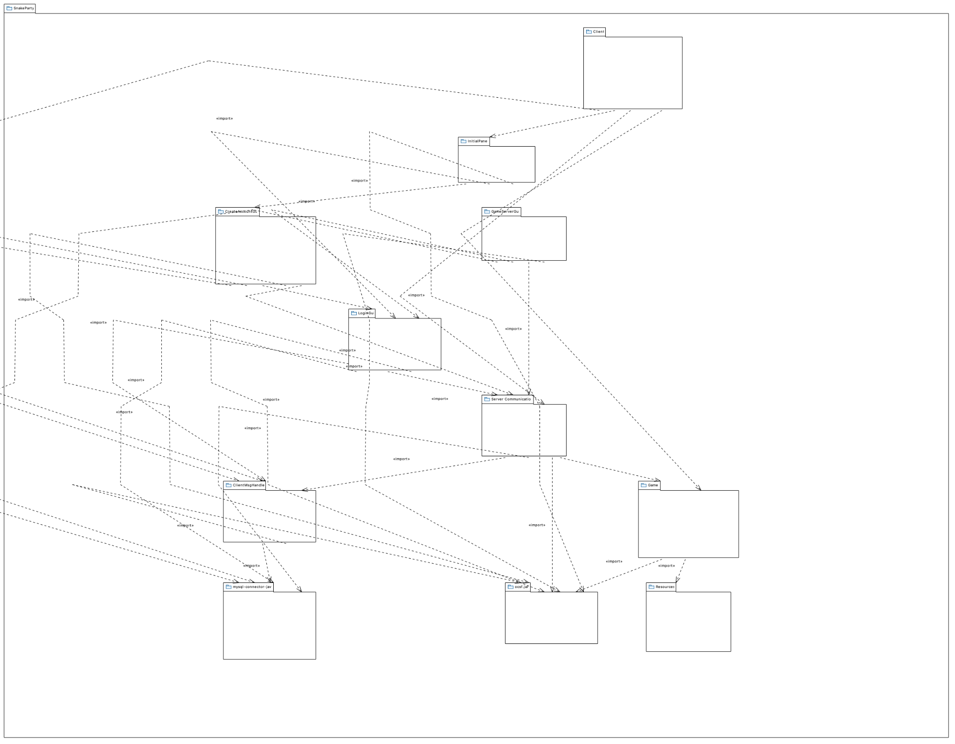
Final Package Diagram
We utilized an extension called Saros to do collaborative programming since we were struggling to stay in sync with each other and dealing with a lot of git conflicts.
Ultimately, our development was based around code session with everyone working together on every part of the application with different people “driving” the sessions.
https://marketplace.eclipse.org/content/saros-distributed-collaborative-editing-and-pair-programming

Slide 4
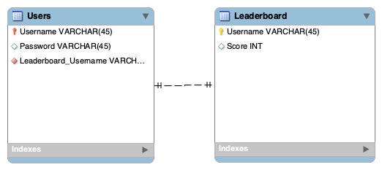
Final Database Design Diagram

Slide 5

Functional Requirement Example
User must be able to start a game

Slide 6
Use Case Description Example
Use Case Name: Start Game
Actors: Existing User
User selected user player
User presses start the game
User is entered into an active game
Entry Condition:
User selected
Exit Condition:
Game starts

Slide 7
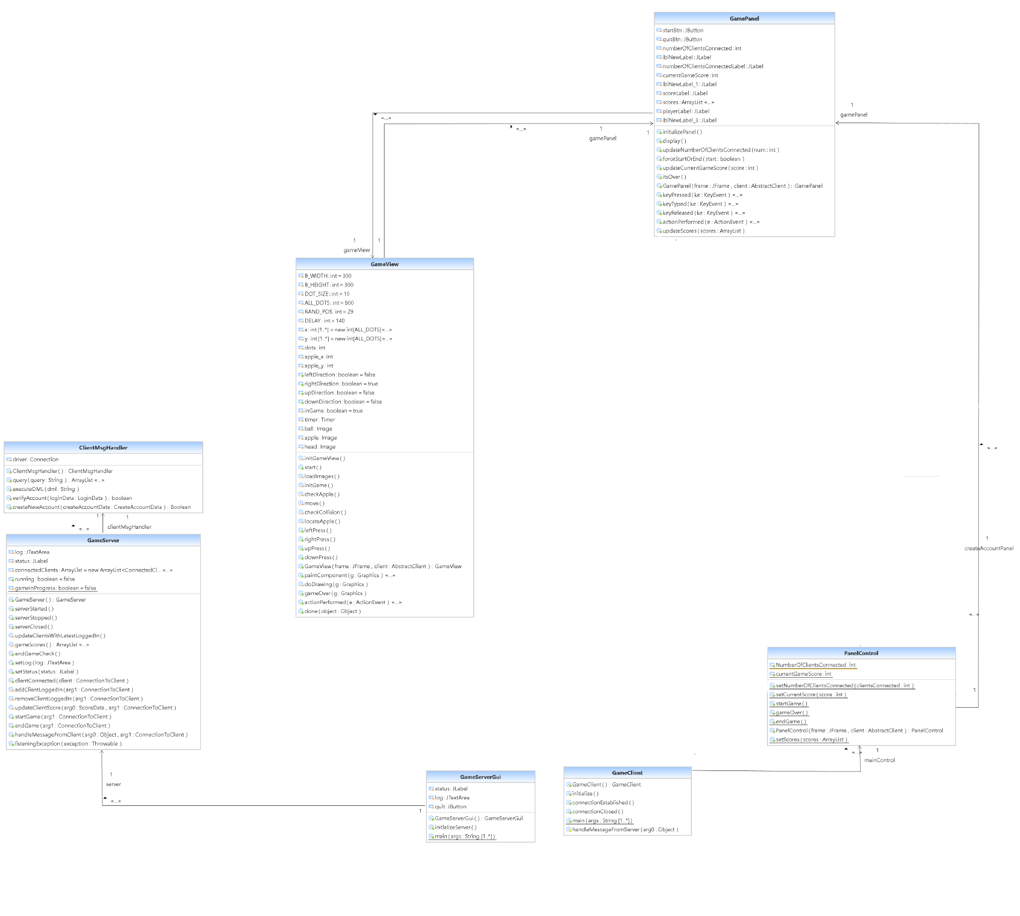
FInal Class Diagram
-GameClient receives “Start” from GameServer
-PanelStart displays GamePanel
-GamePanel starts GameView

Slide 8
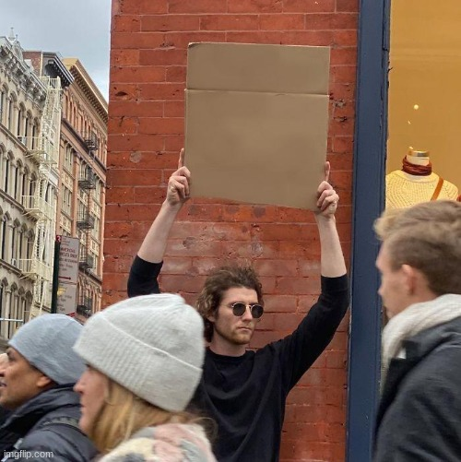
Demonstration
Snake party
4every1

